Slide 1
Chapter 4 Combinational Logic Design Principles
本章重点
1、开关代数：公理、定理、逻辑电路的函数表达
2、组合电路的分析：组合电路的结构、逻辑表达式、真值表、时序图等。
3、组合电路的综合（设计）：逻辑抽象定义电路的功能，写出逻辑表达式，得到实际的电路。

Slide 2
Chapter 4 exercises
The first homework
4.4 4.5 4.6 4.7(a,h) 4.9(b, d, f)
4.25 4.28 4.35
The second homework
4.15(a, c, e) 4.18(c, d) 4.47 4.54
4.55 4.56 4.59(d, e)

Slide 3

Combinational logic circuit
The outputs depend only on its current inputs.
Any combinational function can be specified as a truth table or a Boolean expression.
In 1854, George Boole, two-valued algebraic system -- Boolean algebra
In 1938, Claude E. Shannon(1916-2001) adapt Boolean algebra to analyze and describe the behavior of circuits built from relays –switching algebra.
Shannon

Slide 4
4.1 Switching Algebra
Symbolic
Boolean values : 0, 1
Boolean operators ：+, ·, ’
1、Axioms
AND operation
(logic amplification)
OR operation
(logic addition)

Slide 5
2. Single Variable Theorems
(T1) X+0=X (T1’) X·1=X
Identities(自等律)
(T2) X+1=1 (T2’) X·0=0
Null elements (0-1律)
(T3) X+X=X (T3’) X·X=X
Idempotency (同一律)
(T4) (X’)’=X
Involution (还原律)
(T5) X+X’=1 (T5’) X·X’=0
Complements (互补律)
Proofs by perfect induction
all values of the variable are substituted in the equation of a theorem , if it is true for both side of the equal sign, then the theorem is proved.

Slide 6
3. two-and three-variable theorems
(T6) X+Y=Y+X (T6’) X·Y=Y·X
commutativity（交换律）
Associativity
（结合律）
(T7) (X+Y)+Z=X+(Y+Z) (T7’) (X·Y)·Z=X·(Y·Z)
Parenthesization or order of the terms in a logical sum or logical product is irrelevant.
(T8) X·Y+X·Z=X·(Y+Z) (T8’) (X+Y)·(X+Z)=X+Y·Z
Distributivity
（分配律）
logical multiplication distributes over logical addition
logical addition distributes over logical multiplication
Operating priority: prime(’), parentheses, AND, OR

Slide 7
(T9) X+X·Y=X (T9’) X·(X+Y)=X
covering（吸收律）
(T10) X·Y+X·Y’=X (T10’) (X+Y)·(X+Y’)=X
Combining
（组合律）
T9、T9’、T10、T10’: be used to simplify logic functions.
(T11) X·Y+X’·Z+Y·Z=X·Y+X’·Z
(T11’) (X+Y)·(X’+Z)·(Y+Z)=(X+Y)·(X’+Z)
consensus（一致律）
Y·Z and (Y+Z) term are the redundant terms in the expression.
Supplement：
A+A’B=A+B （消因律）
A’+AB=A’+B

Slide 8
4. n-variable theorems
(T12) X+X+…+X=X (T12’) X·X·…·X=X
Generalized idempotency
(广义同一律)
(T13) (X₁·X₂·……·X_{n})’=X₁’+X₂’+……+X_{n}’
(T13’) (X₁+X₂+……+X_{n})’=X₁’·X₂’·……·X_{n}’
DeMorgan theorems
T13--- equivalent transform between “AND-NOT” and “NOT-OR”.
T13’--- equivalent transform between “OR-NOT” and “NOT-AND”.
Exp. ：G=X’·Y+V·W’·Z ——— =？
DeMorgan theorems

Slide 9
(T14) [F(X₁,X₂,……,X_{n}, + , · )]’=F(X₁’,X₂’,……X_{n}’, · , +)
T14—Generalized DeMorgan’s theorem (也称为“反演定理”), get the complement of a logic expression (inverse function)。
keep the original operating order;
complement all variables;
swapping ‘0’ and ‘1’;
swapping ‘+’ and ‘·’
（the expression in brackets with a prime must keep the prime in the inverse function.）
exp：give the inverse function of the equation :
F=[(A·B’+C)·E]’+G’

Slide 10
(T15) F(X₁,X₂,…,X_{n})=X₁·F(1,X₂,…,X_{n})+X₁’ ·F(0,X₂,…,X_{n})
(T15’) F(X₁,X₂,…,X_{n})=[X₁+F(0,X₂,…,X_{n})] ·[X₁’+F(1,X₂,…,X_{n})]
(Shannon’s expansion theorems)
finite induction
（1）proving the theorem is true for n=2;
（2）then proving that if the theorem is true for n=i, then it is also true for n=i+1.

Slide 11
5. Duality
Any theorem or identity in switching algebra remains true if 0 and 1 are swapped and ‘·’ and ‘+’ are swapped throughout.
a logic expression： F(X₁,X₂,……,X_{n}, ’ , + , ·)
its duality：F^{D}=F(X₁,X₂,……,X_{n}, ’ , · , +)
X·Y———X+Y 0———1
Exp.：find the duality expression .
F=(A·B+A’·C)’+1·B
unchanged
swapped
duality
duality

Slide 12
Properties of duality
inverse function and duality：
[F(X₁,X₂,……,X_{n}, + , · ,’)]’= F^{D}(X₁’,X₂’,……,X_{n}’, · , + ,’)
logic convention & duality :
For a logic function, its positive logic expression and negative logic expression are duality.
That means:
positive logic negative logic
AND = OR
OR = AND
NAND = NOR
NOR = NAND

Slide 13
6. Using switching algebra in minimizing logic function
Exp.：
（1）F=AD+AD’+AB+A’C+BD+AB’EF+B’EF
（2）F=A·（B’+C）’·（BC）’
（3）F=AB+AC’+B’C+C’B+CD’+BD’
+ADE(F+G)

Slide 14

7. Standard representation of logic functions
X
Y
F
Z
How to describe the relation between input (X,Y,Z) and output (F) for the logic circuit (logic function)?
truth table
Algebraic representation
canonical sum
canonical product
……
methods

Slide 15
truth table
n input variable ----2^{n} row at most
input
output
X | Y | Z | F(X,Y,Z)
0 | 0 | 0 | 1
0 | 0 | 1 | 0
0 | 1 | 0 | 0
0 | 1 | 1 | 1
1 | 0 | 0 | 1
1 | 0 | 1 | 0
1 | 1 | 0 | 1
1 | 1 | 1 | 1
The effective output values may less than 2^{n}, that means some inputs are invaluable.

Slide 16
Algebraic representation
Refer to the circuit, we can write :
F=X·Z’+Y·Z+Y’ ·Z’ OR F=(X+Y’+Z) ·(Y+Z’)
distributivity
Some definitions:
Literal
a variable or its complement
product term
X·Y·Z’，A·B’·G·G，R
sum-of-products (SOP)
sum term
C+D+H’，X+X+W’
product-of-sums (POS)
normal term (标准项)
X·Y·Z’, A+B+C’+D’

Slide 17
☆ n-variable minterm
normal product term with n literals
Exp. 3-variable X, Y, Z
one minterm
minterm
X’·Y’·Z’
X’·Y’·Z
X’·Y·Z’
X’·Y·Z
X·Y’·Z’
X·Y’·Z
X·Y·Z’
X·Y·Z
X | Y | Z
0 | 0 | 0
0 | 0 | 1
0 | 1 | 0
0 | 1 | 1
1 | 0 | 0
1 | 0 | 1
1 | 1 | 0
1 | 1 | 1
minterm designation
m₀
m₁
m₂
m₃
m₄
m₅
m₆
m₇
one binary combination
one combination only let one minterm be 1
one n-variable minterm represent one n-variable combination .

Slide 18
☆ n-variable maxterm
normal sum term with n literals
maxterm
X+Y+Z
X+Y+Z’
X+Y’+Z
X+Y’+Z’
X’+Y+Z
X’+Y+Z’
X’+Y’+Z
X’+Y’+Z’
X | Y | Z
0 | 0 | 0
0 | 0 | 1
0 | 1 | 0
0 | 1 | 1
1 | 0 | 0
1 | 0 | 1
1 | 1 | 0
1 | 1 | 1
maxterm designation
M₀
M₁
M₂
M₃
M₄
M₅
M₆
M₇
one maxterm
one maxterm
one binary combination
one combination only let one maxterm be 0
one n-variable maxterm also represent one n-variable combination .

Slide 19
properties of minterm and maxterm
①properties of minterm
a、所有输入组合取值中，只有一组取值能令特定的某个最小项的值为1。
b、任意两个不同最小项之积为0，m_{i}×m_{j}=0 i≠j
c、全部最小项之和为1，
②properties of maxterm
a、所有输入组合取值中，只有一组取值能令特定的某个最大项的值为0。
b、任意两个不同最大项之和为1， M_{i}+M_{j}=1 i≠j
c、全部最大项之积为0，
③ 编号相同的最小项和最大项互为反函数
m_{i}=(M_{i})’， M_{j}=(m_{j})’

Slide 20
☆ canonical sum - construct an AND-OR circuit
sum of minterms
corresponding to input combination for which the function produces a 1 output.
Exp.
F=？
=X’·Y’·Z’+X’·Y·Z+X·Y’·Z’
+X·Y·Z’+X·Y·Z
=Σ_{X,Y,Z}(0, 3, 4, 6, 7)
input
output
X | Y | Z | F
0 | 0 | 0 | 1
0 | 0 | 1 | 0
0 | 1 | 0 | 0
0 | 1 | 1 | 1
1 | 0 | 0 | 1
1 | 0 | 1 | 0
1 | 1 | 0 | 1
1 | 1 | 1 | 1
AND-OR
or =m₀+m₃+m₄+m₆+m₇
minterm list

Slide 21
☆ canonical product - construct an OR-AND circuit
product of maxterms
corresponding to input combination for which the function produces a 0 output.
Exp.
F=(X+Y+Z’)·(X+Y’+Z)·(X’+Y+Z’)
=∏_{X,Y,Z}(1,2,5)
or
=M₁·M₂·M₅
X | Y | Z | F
0 | 0 | 0 | 1
0 | 0 | 1 | 0
0 | 1 | 0 | 0
0 | 1 | 1 | 1
1 | 0 | 0 | 1
1 | 0 | 1 | 0
1 | 1 | 0 | 1
1 | 1 | 1 | 1
OR-AND
maxterm list

Slide 22
Conversion between maxterm list and minterm list
n variable logic function
minterm list
maxterm list
k terms
j terms
k+j=2^{n}
k minterm numbers
j maxterm numbers
Complement subset of the 2^{n} numbers
∴若已知标准和，则集合{0,…,2^{n}-1}中剩下的编号就可以构建标准积；反之亦然。
例：∑_{XYZ}（0、2、3、5）=∏_{XYZ}（1、4、6、7）

Slide 23
inverse function of a canonical logic expression：
A canonical sum: F=…+m_{i}+m_{j}+… i≠j
Its inverse function is:
F’=…· M_{i} · M_{j} · … i≠j, vice versa.
Representation of a logic function
① circuit
② truth table
③ equation
canonical sum , canonical product, and uncanonical algebra representation
④ number list
minterm list, maxterm list
⑤ word description,…

Slide 24
4.2 Combinational-Circuit Analysis
A
fill the truth table
B
F
A | B | C | F
0 | 0 | 0 | 1
… | … | … | …
1 | 1 | 1 | 0
C
verify that circuit is combinational.
Canonical sum or product
Algebraic representation: F=f(A,B,C)
Minimizing the equation
write the algebraic representation according to the circuit directly
A
timing diagram
B
C
F
……

Slide 25
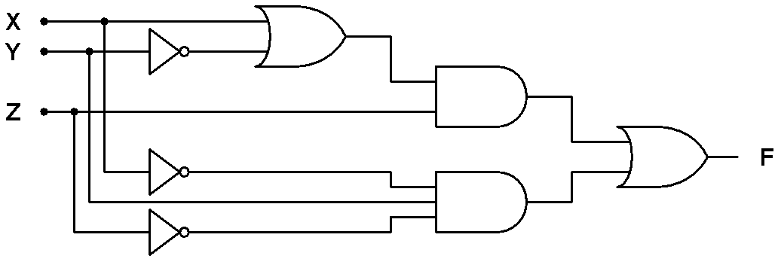
Analyzing example
X | Y | Z
0 | 0 | 0
0 | 0 | 1
0 | 1 | 0
0 | 1 | 1
1 | 0 | 0
1 | 0 | 1
1 | 1 | 0
1 | 1 | 1
F
0
1
1
0
0
1
0
1
Input
Output
Single direction, it’s a combinational circuit
F=Σ_{X,Y,Z}(1,2,5,7)=X’·Y’·Z+X’·Y·Z’+X·Y’·Z+X·Y·Z
F=1
OR
F=Π_{X,Y,Z}(0,3,4,6) =(X+Y+Z)·(X+Y’+Z’)·(X’+Y+Z)·(X’+Y’+Z)

Slide 26
Other analysis
Minimizing the expression
F=Σ_{X,Y,Z}(1,2,5,7)
=X’·Y’·Z+X’·Y·Z’+X·Y’·Z+X·Y·Z
=X·Z+Y’·Z+X’·Y·Z’
OR
F=Π_{X,Y,Z}(0,3,4,6)
=(X+Y+Z)·(X+Y’+Z’)·(X’+Y+Z)·(X’+Y’+Z)
=(Y+Z)·(X’+Z)·(X+Y’+Z’)
Write the logic expression according to the circuit
F=((X+Y’)·Z)+X’·Y·Z’

Slide 27
Two-level structure of logic circuit
Two types
implement sum-of products expression
“AND — OR”
Manipulated by
De’Morgan theorem
“NAND — NAND”
implement product-of sums expression
“OR — AND”
“NOR — NOR”

Slide 28
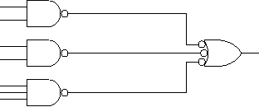
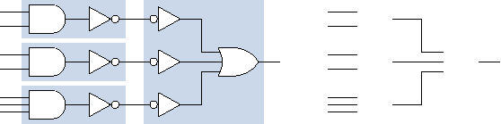
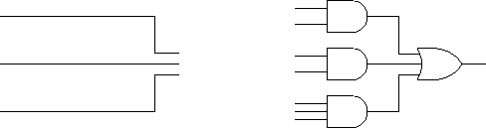
“AND-OR” and “NAND-NAND”
AND — OR
first-level
second-level
NAND — NAND

Slide 29

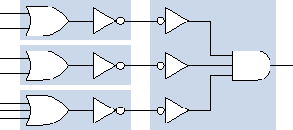
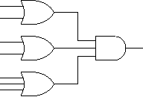
“OR-AND” and “NOR-NOR”
OR-AND
first-level
second-level
NOR-NOR

Slide 30
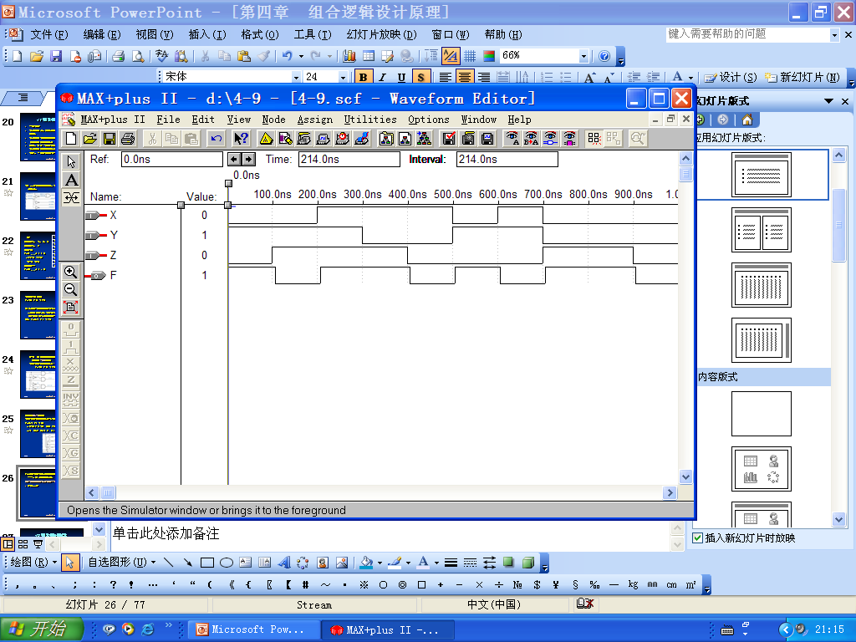
Timing diagram

Slide 31
4.3 Combinational-Circuit Synthesis
Synthesis requirements：
analyze the word description, make sure that it could be implemented by combinational-circuit；
Find all input and output variable ；
Use truth table to represent the input-output logic relation；
Use karnaugh-map to minimize the logic expression；
Give the logic circuit diagram
?
Logic function
input ?
…
…
output ?

Slide 32
1、circuit descriptions and designs
Exp1：design a 4-bit prime-number detector.
4-bit binary number
4-bit
Prime-number detector
Yes or No
N₃N₂N₁N₀
Yes: F=1 No: F=0
N₃ | N₂ | N₁ | N₀
0 | 0 | 0 | 0
0 | 0 | 0 | 1
0 | 0 | 1 | 0
0 | 0 | 1 | 1
0 | 1 | 0 | 0
0 | 1 | 0 | 1
0 | 1 | 1 | 0
0 | 1 | 1 | 1
F
0
1
1
1
0
1
0
1
N₃ | N₂ | N₁ | N₀
1 | 0 | 0 | 0
1 | 0 | 0 | 1
1 | 0 | 1 | 0
1 | 0 | 1 | 1
1 | 1 | 0 | 0
1 | 1 | 0 | 1
1 | 1 | 1 | 0
1 | 1 | 1 | 1
F
0
0
0
1
0
1
0
0
F=Σ_{N3,N2,N1,N0} (1,2,3,5,7,11,13)

Slide 33
Exp2：alarm circuit—
PANIC
1
alarm circuit
ENABLE
1
EXITING
0
ALARM
WINDOW
no
SECURE
DOOR
GARAGE
ALARM=PANIC+EN·EXT’ ·SEC’
SECURE=WINDOW·DOOR·GARAGE
ALARM=PANIC+EN·EXT’ ·(W·D·G)’

Slide 34

3、combinational-circuit minimization
Whether canonical sum (or product) is the final expression or not?
Is the expression simplified further more?
no
yes
How do I know whether the simplest circuit is done?
Then the circuit is final result.
Need to be minimized
Obtain the minimized expression

Slide 35
Minimizing methods
Minimizing by switching algebra
Minimizing by karnaugh map
Minimization methods (base on two-level structure)
Minimizing the number of first-level gates
Minimizing the number of inputs on each first-level gates
Basing on：T10、T10’
X·Y+X·Y’=X；(X+Y)·(X+Y’)=X

Slide 36
4、Karnaugh Map
graphical representation of a logic function’s truth table .
①structure
n-variable k-map has 2^{n} cells.
1-var k-map
2-var k-map
F（X，Y）
output
input
F
F
X
X
0
1
0
1
Y
0
1
0
0
2
1
1
3
each cell has a number which correspond to a minterm number in a truth table.

Slide 37
3-var k-map
F（X，Y，Z）
4-var k-map
F（W, X, Y, Z）
XY is arranged in Gray code.
X
F
W
WX
F
YZ
00
01
11
10
XY
00
01
11
10
Z
00
0
4
12
8
0
0
2
6
4
01
1
5
13
9
1
1
3
7
5
Z
Z
11
3
7
15
11
Y
Y
10
2
6
14
10
The bracket represents that a variable is 1 in the column cells or in row cells
the contents of the cells are output-value corresponding to each input combination
X

Slide 38
② fill in the k-map for a given truth table
Copy 1s and 0s from the truth table to the corresponding cells of the map.
Exp：
truth table k-map？
X | Y | Z | F
0 | 0 | 0 | 0
0 | 0 | 1 | 1
0 | 1 | 0 | 1
0 | 1 | 1 | 0
1 | 0 | 0 | 0
1 | 0 | 1 | 1
1 | 1 | 0 | 0
1 | 1 | 1 | 1
X
F
X Y
00
01
11
10
Z
0
1
0
0
0
1
1
0
1
1
Z
Y

Slide 39
fill in the k-map for a given number list
F=∑_{X,Y,Z}（1,3,4,6）
F=Π_{X,Y,Z}(3,5,6)
Order of the variables is related with the cell’s number (minterm’s number)
F
X
F
X
X Y
X Y
00
01
11
10
00
01
11
10
Z
Z
0
0
1
1
1
1
0
1
0
0
1
1
0
0
Z
1
0
1
0
Z
1
1
Y
Y

Slide 40
5、minimizing sums of products
base on：T10、T10’
X·Y+X·Y’=X (X+Y)·(X+Y’)=X
combine two adjacent “1” cell into a product term and eliminate one literal.
X | Y | Z | F
0 | 0 | 0 | 1
0 | 0 | 1 | 1
0 | 1 | 0 | 0
0 | 1 | 1 | 0
1 | 0 | 0 | 0
1 | 0 | 1 | 0
1 | 1 | 0 | 1
1 | 1 | 1 | 1
F=X’·Y’·Z’+X’·Y’·Z+X·Y·Z’+X·Y·Z
=X’·Y’·(Z’+Z)+X·Y·(Z’+Z)
=X’·Y’+X·Y
F
X
X Y
00
01
11
10
Z
1
0
1
0
0
1
0
1
0
Z
1
Y

Slide 41
（1）adjacent (wrapround)
input combinations of adjacent cells only differ in one variable，that is also called wrapround.
F
W
X
WX
F
YZ
00
01
11
10
XY
00
01
11
10
Z
00
0
01
1
Z
Z
11
Y
Y
adjacent
10
adjacent
X
adjacent
adjacent

Slide 42
（2）methods of minimization
circle 2^{i} adjacent “1”cells, it will be a new product term with (n-i) literals.
the circle must be promised the biggest one, if enlarge the circle, then “0”cell may be included。
the combined product term is called prime implicant，PI。
F
W
W X
Y Z
00
01
11
10
00
0
1
0
1
01
1
0
0
1
Z
11
0
0
1
1
Y
10
0
1
0
1
W X
W
X
Y Z
00
01
11
10
00
0
1
0
1
Not the biggest circle
01
1
0
0
1
Z
11
0
0
1
1
Y
10
0
1
0
1
X

Slide 43
derive prime implicant (product term)
in areas covered by the circle
So, this term is W’ ·X·Z’
① a variable is 0, then it is complemented in the product term.
W=0, Z=0 → W’ ·Z’
F
W
W X
② a variable is 1, then it is uncomplemented in the product term.
Y Z
00
01
11
10
00
0
1
0
1
X=1 →X
1
0
0
1
01
Z
③a variable is 0 as well as area where it is 1, then it isn’t appear .
11
0
0
1
1
Y
10
0
1
0
1
Y=1 & Y=0
X

Slide 44
Exp
F
W
W X
The circle more big, the variable disappeared more.
Y Z
00
01
11
10
W·X’
00
0
1
0
1
X’·Y’·Z
01
1
0
0
1
Z
11
0
0
1
1
Y
10
0
1
0
1
W·Y·Z
X
W’·X·Z’
F= X’Y’Z+ W’XZ’+ WYZ+ WX’
complete sum— sum of all prime implicants.

Slide 45
minimal sum
Complete sum may not the minimal sum, so
find the distinguished “1” cell
make sure the Essential Prime Implicant, EPI
minimal sum is the sum of EPI.

Slide 46
distinguished “1” cell
F
W
W X
Y Z
00
01
11
10
0
1
0
1
00
01
1
0
0
1
Z
11
0
0
1
1
For this example,
complete sum = minimal sum
F= X’Y’Z+ W’XZ’+ WYZ+ WX’
Y
10
0
1
0
1
X

Slide 47
Exp1：
W
complete sum：F=Y’Z+XZ’+XY’
F
W X
00
01
11
Y Z
0
1
1
0
00
1
1
1
1
minimal sum：F=Y’Z+XZ’
01
Z
11
0
0
0
0
Y
10
0
1
1
0
X

Slide 48
Exp2：derive the simplest minimal sum by k-map.
F=AC’+A’C+B’C+BC’
rules：
按照表达式中出现的变量个数，画好方格图；
再由每个积项确定方格图中的质蕴含项(由积项中出现的变量因子对应于图中的区域的交叉部分填入“1”即可。)
A
F
A
F
AB
AB
00
00
01
01
11
11
10
C
10
C
0
0
1
1
1
0
1
1
1
0
1
1
C
C
B
B

Slide 49
Continue Exp.2
F
A
AB
C
00
01
11
10
0
1
1
1
Another answer ?
1
1
1
1
C
B
There are two results for this exp..
They have same number of product terms and each term has same literals.
A “AND-OR” logic function maybe have more than one minimal sum.

Slide 50
Exp3. minimize the logic equation
F=A’·B’·C’·D+A’·B·D’+A·C·D+A·B’+A’ ·B’ ·C’ ·D’, represent it by k-map.
solution：F=？
F
A
AB
00
01
11
10
CD
1
1
0
1
00
1
0
0
1
01
D
11
0
0
1
1
C
10
0
1
0
1
B

Slide 51
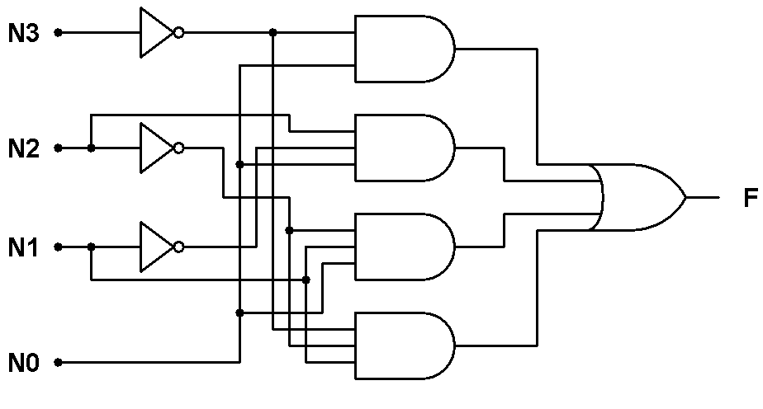
Combinational circuit design example
Exp1：design the simplest logic circuit of the 4-bit prime-number detector.
F=∑_{N3N2N1N0}（1，2，3，5，7，11，13）
F
minimal sum:
F=N3’·N0+N2·N1’·N0+N2’·N1·N0+N3’·N2’·N1
N3N2
N3
N1N0
00
01
11
10
00
1
1
1
01
N0
1
1
1
11
N1
1
10
N2

Slide 52
Combinational circuit design example
Exp.2：design a 3-bit Gray code → binary code decoder.
Solution: set Gray code : G₂G₁G₀ ,
binary code: B₂B₁B₀
B2
B2=G2
G2
G2G1
G0
0 | 0 | 1 | 1
0 | 0 | 1 | 1
G2 | G1 | G0 | B2 | B1 | B0
0 | 0 | 0 | 0 | 0 | 0
0 | 0 | 1 | 0 | 0 | 1
0 | 1 | 1 | 0 | 1 | 0
0 | 1 | 0 | 0 | 1 | 1
1 | 1 | 0 | 1 | 0 | 0
1 | 1 | 1 | 1 | 0 | 1
1 | 0 | 1 | 1 | 1 | 0
1 | 0 | 0 | 1 | 1 | 1
G0
B1
G1
G2
G2G1
G0
0 | 1 | 0 | 1
0 | 1 | 0 | 1
B1=G2’ ·G1+G2·G1’
G0
G1
B0
G2
B0=G2’ ·G1’ ·G0
+G2’ ·G1·G0’
+G2·G1·G0
+G2·G1’ ·G0’
G2G1
G0
0 | 1 | 0 | 1
1 | 0 | 1 | 0
G0
G1

Slide 53
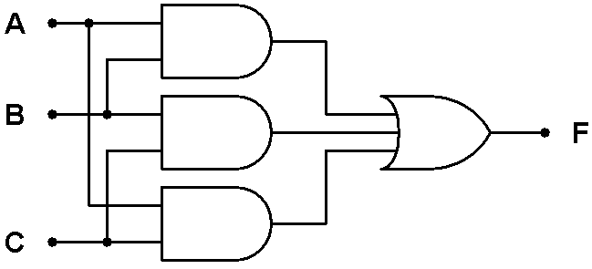
Combinational circuit design example
Exp3：design a 3-bit majority-rule circuit, that means the output value is as same as the most of input bits.
F
AB
A
A | B | C | F
0 | 0 | 0 | 0
0 | 0 | 1 | 0
0 | 1 | 0 | 0
0 | 1 | 1 | 1
1 | 0 | 0 | 0
1 | 0 | 1 | 1
1 | 1 | 0 | 1
1 | 1 | 1 | 1
C
0 | 0 | 1 | 0
0 | 1 | 1 | 1
C
B
F=A·B+B·C+A·C

Slide 54
Combinational circuit design example
Exp.4：A temperature detector have four sensors settled properly in a room. When two or more sensors output high level, the detector output 1 ,otherwise output 0.
Exp.5：finish the following operation by using k-map.
Known F₁=BC’+C’D’+B’CD and F₂=AD’+CD+A’B’C’，do F_{A}=F₁·F₂，F_{B}=F₁+F₂。

Slide 55
（3）k-map more than 4-variable
5-variable，32 cells，let variables are V、W、X、Y、Z
W
Arrange In Gray code
F
V
VWX
YZ
000
001
011
010
110
111
101
100
00
0 | 4 | 12 | 8 | 24 | 28 | 20 | 16
1 | 5 | 13 | 9 | 25 | 29 | 21 | 17
3 | 7 | 15 | 11 | 27 | 31 | 23 | 19
2 | 6 | 14 | 10 | 26 | 30 | 22 | 18
01
Z
11
Y
10
Number of cell
adjacent
X

Slide 56
Dividing into two part
According to Shannon’s expansion theorems
F1
F2
W
W
WX
WX
YZ
00
01
11
10
00
01
11
10
YZ
0
4
12
8
16
20
28
24
00
00
1
5
13
9
17
21
29
25
01
01
Z
Z
11
3
7
15
11
19
23
31
27
11
Y
Y
2
6
14
10
18
22
30
26
10
10
X
V=0
V=1
X
F1=V’ ·F(0,W,X,Y,Z)
F2=V ·F(1,W,X,Y,Z)

Slide 57
Exp.
find the minimal sum of the following function
F=∑_{V,W,X,Y,Z}（7,8,9,10,11,12,23,24,26,28）
W X
W
W X
W
Y Z
Y Z
1
1
1
1
1
Z
Z
1
1
1
Y
Y
1
1
V=0
V=1
X
X

Slide 58
6、minimizing “product-of-sums”
Combining adjacent 2^{i} “0”cell, get a new sum term with (n-i) literals.
or derive the minimal sum F’∑ of the inverse function first；then complement the F’∑, so the minimal product F∏ could be derived.
Exp.
F
W
W X
Y Z
00
01
11
10
F’=WYZ’+W’YX’+X’Z’
00
0
1
1
0
01
1
1
1
1
F=(W’+Y’+Z)·(W+X+Y’)·(X+Z)
Z
11
0
1
1
1
Y
10
0
1
0
0
X

Slide 59
7、“don’t-care” input combinations
The output doesn’t matter for certain input combination (maybe never occur in normal condition). These are called don’t care terms.
Use symbol “d”、“×”、“ Φ” to represent the output value.
In minimization, don’t care term could be used as “1” or “0” if necessary.

Slide 60
Exp.1
No use, no circle
F
A
AB
F=C’·D+A·B’·D+A’·C·D
CD
00
01
11
10
0
0
d
0
00
1
1
d
1
01
D
11
0
0
0
1
C
10
1
d
0
0
B

Slide 61
Exp.2：a BCD prime-number detector.
0000~1001: valid input BCD; 1010~1111: invalid input, so output don’t care。
BCD input
Result
Yes: F=1
No: F=0
4
BCD prime-number detector
F
N3N2
N3
N1N0
d
F=N3’·N0+N2’·N1
1
1
d
N0
1
1
d
d
N1
1
d
d
N2

Slide 62
Exp.3：minimizing the following expression to minimal sum and “NAND-NAND” representation.
F=A’·B’·C’+A’·B·D’+A’·C·D+A·B·C
A·B’+A·C’=0 (约束项)
约束无关项—输入变量的取值组合受到约束，这些输入组合对应的输出也是任意的。
即，使得约束项等于1的输入取值不可能出现。
That means: ABCD=10×× and ABCD=1×0× never appear on the input.

Slide 63
the k-map
minimization
F
A·C’
A·B’
A B
F
A
A B
C D
A
1
1
d
d
C D
1
1
d
d
1
d
d
1
d
d
D
1
1
1
d
D
C
1
1
1
d
1
1
d
C
1
1
d
B
B
Restricted terms: A·C’, A·B’.
Also be treated as don’t-care input combinations.

Slide 64
8、multiple-output minimization
using common terms adequately.
Exp：F=∑_{XYZ}(3,6,7), G=∑_{XYZ}(0,1,3), derive the circuit.：
(1) synthesis individually
F
X
G
X
X Y
X Y
Z
00
01
11
10
Z
00
01
11
10
0
0
0
1
0
0
1
0
0
0
1
0
1
1
0
Z
1
1
1
0
0
Z
Y
Y
F=X·Y+Y·Z
G=X’·Y’+X’·Z

Slide 65
(2) circle the common terms in multiple-output K-maps
Algorithm
①find the m-product function of all output.
②circle the m-product’s EPI. (the common part)
③find the EPI in the leaving “1”cell.
④combining step②、③, get the final circuit.
F·G
X
X Y
Z
00
01
11
10
0
0
0
0
0
1
0
1
0
0
Z
Y
X’·Y·Z

Slide 66
F
X
G
X
重新划出主质蕴含项
X Y
X Y
Z
00
01
11
10
Z
00
01
11
10
0
0
0
1
0
0
1
0
0
0
1
0
1
1
0
Z
1
1
1
0
0
Z
Y
Y
F·G
X
X Y
F=X·Y+X’·Y·Z
Z
00
01
11
10
0
0
0
0
0
G=X’·Y’+X’·Y·Z
1
0
1
0
0
Z
Y
The overall product terms is reduced.
X’·Y·Z

Slide 67
列表法
 | 主蕴含项 | 最小项
 |  | 0 | 1 | 3 | 6 | 7
F | {3 ,7} |  |  | √ |  | √
 | {6 ,7} |  |  |  | √ | √
G | {0 ,1} | √ | √
 | {1 ,3} |  | √ | √

Slide 68
4.5 Timing Hazards
A Static Hazard is defined when a single variable change at the input causes a momentary change in another variable [the output].
A Dynamic Hazard occurs when a change in the input causes multiple changes in the output.
keywords：glitch、hazard
reason: delay
Static Hazard: static-1, static-0 hazards

Slide 69
1、static hazards
①static—1 hazards
definition：a pair of input combination
（a）differ in only one variable
（b）both output 1
when this differing input change ,a momentary 0 output maybe occurred.
Exp：F=X·Z’+Y·Z，assume each gate has the same propagation delay.

Slide 70
when X·Y·Z=111 → 110
X
1
F
X Y
X
00
01
11
10
0
Z
0
0
1
1
1
0
Y
0
1
0
1
1
0
Z
Z
Propagation delay
Y
F=X·Z’+Y·Z
Z’
X·Z’
Y·Z
F
Static-1 hazards occur in SOP implementations.
0 glitch

Slide 71
② static—0 hazards
definition：a pair of input combination
（a）differ in only one variable
（b）both output 0
when the input change ,a momentary 1 output maybe occurred.
Exp： F=(X+Z)·(Y+Z’)
when 000 → 001

Slide 72
0
X
F
X
X Y
00
01
11
10
Y
0
Z
0
0
0
1
1
Z
1
0
1
1
0
Z
Z’
Y
Y+Z’
F=(X+Z)·(Y+Z’)
X+Z
Static 0 hazards occur in 'Product-Of-Sums' [POS] implementations.
F
1 glitch

Slide 73
2、finding static hazards
（1）substitution methods
in a logic function，keep a variable unchanged，and substitute 0 or 1 for other variables, if the function can be minimized to：
F=X_{i}+X_{i}’ ，then static-1 hazard may be exist when X is changed.
F=X_{i} · X_{i}’ , then static-0 hazard may be exist when X is changed.

Slide 74
(2) using k-map
若主质蕴含项（EPI）之间存在相切的部分，则电路可能存在静态冒险。
F
A
A B
C’·D’
C D
00
01
11
10
1
1
1
1
00
1
1
0
0
01
A’·D
D
1
1
0
0
11
C
0
0
0
0
10
B

Slide 75
(3) eliminate the static hazards
引入一致项（consensus，冗余项）：将相切的部分划入一个质蕴含项。
F
A
A B
C’·D’
C D
00
01
11
10
1
1
1
1
A’·C’
00
1
1
0
0
A·D
01
D
1
1
0
0
11
C
得 F=A’·D+C’·D’+A’·C’
0
0
0
0
10
B

Slide 76
1
F
X
X
X Y
0
Z
00
01
11
10
1
0
0
0
1
1
Y
0
1
0
1
1
0
Z
Z
Z’
Y
XZ’
F=X·Z’+Y·Z+X·Y
YZ
XY
1
F
1

Slide 77
第四章小结
开关代数
掌握开关代数的公理、定理。熟练应用于逻辑电路的分析和设计中。
摩根定理、广义摩根定理（反演定理）、对偶定理。
掌握逻辑函数的表示法—真值表、标准和、标准积，及最小项、最大项的定义和性质。

Slide 78
组合逻辑电路的分析
能写出电路的逻辑表达式。
能化简表达式（代数法、卡诺图法）
能作电路结构的变换（“与—或”转“与非—与非”，“或—与”转“或非—或非”）
能对原电路作是否存在“冒险”的判断
能画出正确的时序图。

Slide 79
组合逻辑电路的综合
综合运用所学知识（过去所学的课程）分析、理解设计要求。
将分析所得的输入变量、输出变量及二者间的逻辑关系列入真值表。
化简，画电路
对多输出的处理—一般以各自独立输出方式求解。

Slide 80
定时冒险
掌握冒险可能出现的情况：“与—或”结构可能出现静态—1冒险；“或—与”结构可能出现静态—0冒险。
判断电路中可能出现冒险的地方

Slide 81
Exp.
分析如下电路
根据电路图写出逻辑表达式，判断原电路是否存在冒险。
写出最小积之和式.
若输入信号为以下顺序，无输入延迟时，请画出输出波形。
①
②
③
④
⑤
⑥
⑦
A
B
A
F
B
C
C
D
D
F

Slide 82
试设计一个电路，当输入的4位二进制数能被2整除时，输出Y=1，当输入数能被3整除时，输出Z=1，不满足上述条件时，输出为0。

